Slide 1



Programming HeuristicLab
Algorithms and Problems
A. Scheibenpflug
Heuristic and Evolutionary Algorithms Laboratory (HEAL)
School of Informatics/Communications/Media, Campus Hagenberg
University of Applied Sciences Upper Austria

Slide 2
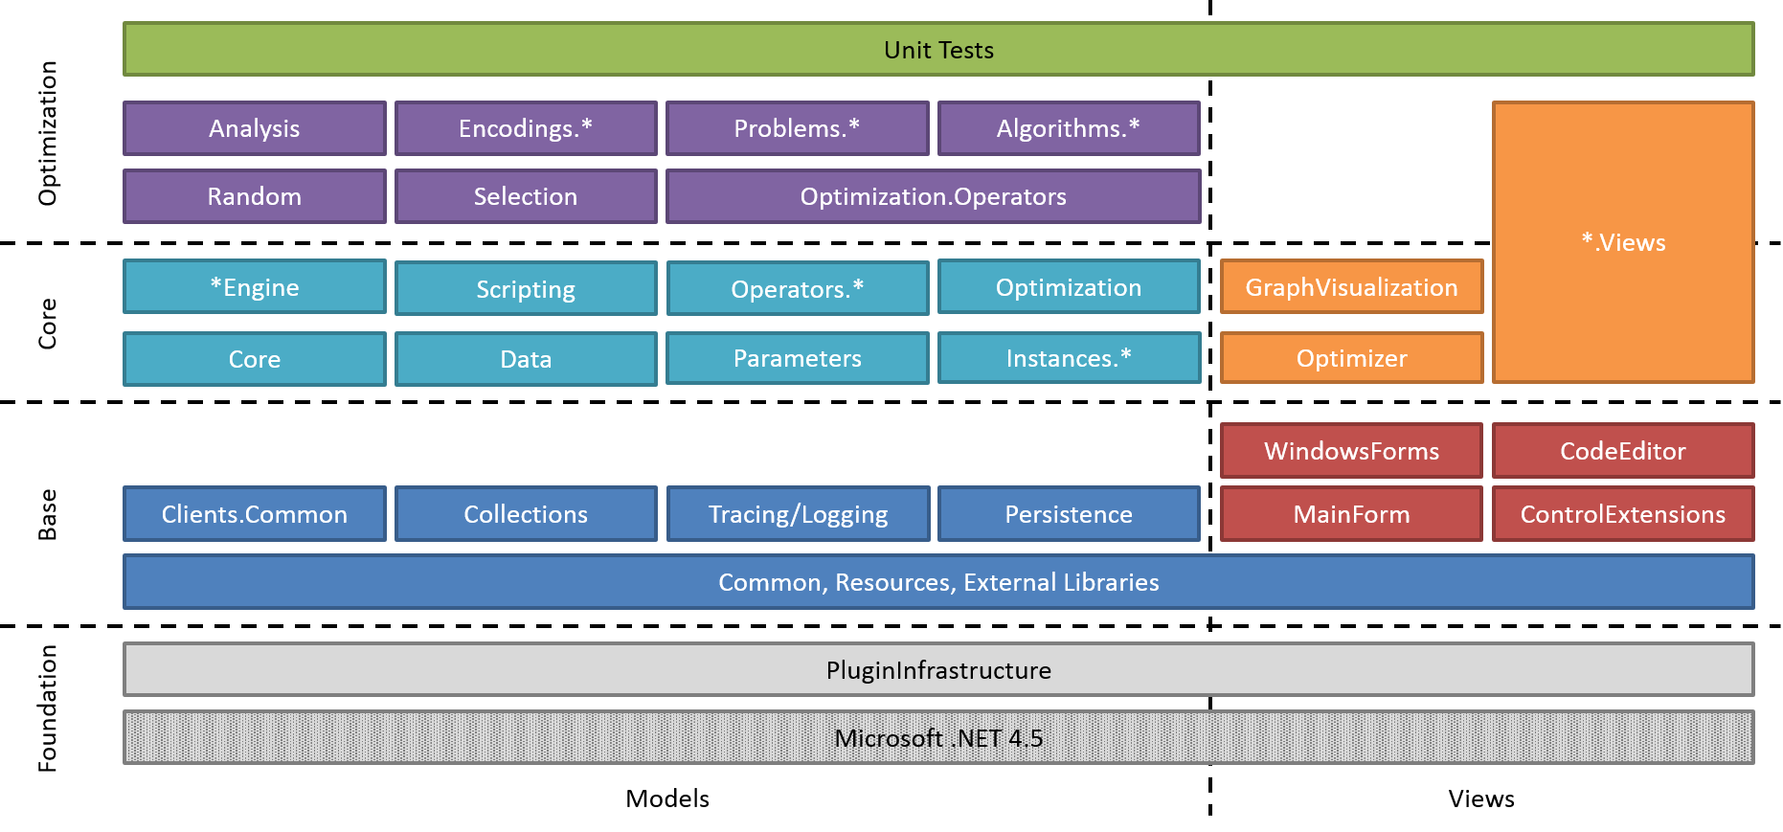
Overview
HL Algorithm Model
Parameters, Operators and Scopes
Algorithms
Problems

Slide 3
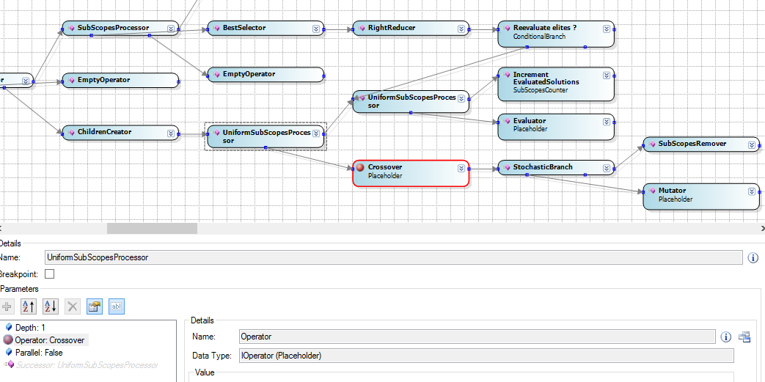
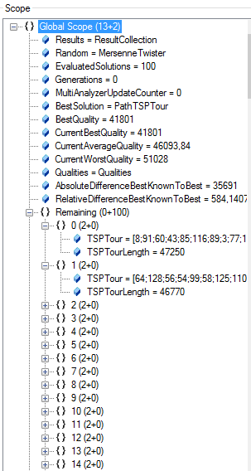
Parameters, Operators and Scopes

Slide 4
HL Algorithm Model
Typically, HL algorithms are constructed by chaining together operators
An engine executes these operators
Enables pausing and debugging
Available engines:
Sequential engine
Parallel engine
Debug engine
(Hive engine)

Slide 5
HL Algorithm Model

Slide 6
Scopes
A scope is a node in the scope tree
Contains link to parent and sub-scopes
Contains variables (e.g., solutions or their quality)
Operators usually work on scopes (either directly or through parameters)
Example - Selection:

Slide 7
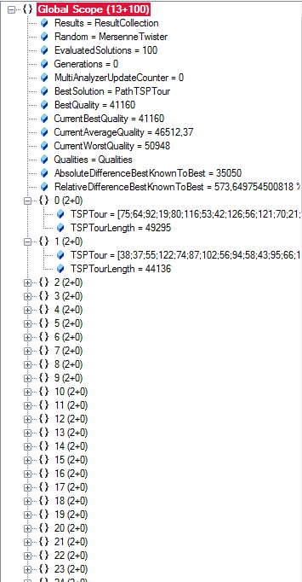
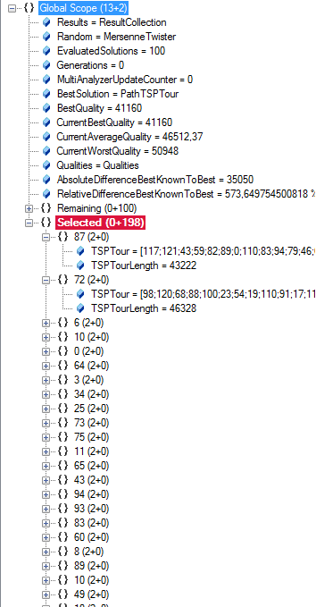
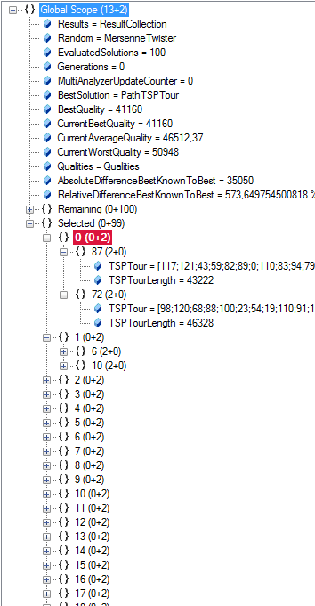
Scopes – Debug Engine

Slide 8
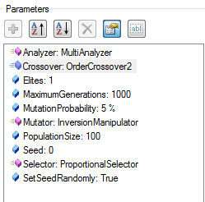
Parameters
Used to configure algorithms, problems and operators
Used for accessing variables in the scope
E.g., population size, analyzers, crossover operator
Operators
Look up these parameters from the algorithm, problem or scope
Use them to store values (in the scope tree)

Slide 9
Parameters
ValueParameter:
Stores a value (Item) that can be looked up; e.g., mutation rate, crossover operator,…
LookupParameter:
Looks up parameters/items (variables) from the scope/parent scopes.
ConstrainedValueParameter:
Contains a list of selectable values.
ScopeTreeLookupParameter:
Goes down the scope tree and looks up variables.
ScopeParameter:
Returns the current scope.
ValueLookupParameter, OptionalConstrainedValueParameter, OperatorParameter, FixedValueParameter, OptionalValueParameter,…

Slide 10
Parameters
Everything that is a ParameterizedNamedItem has a parameters collection
Normally used in the following way:
Add parameter to parameters collection
Implement getter for convenience
Use parameter
Lookup parameter

Slide 11
Add parameter to parameters collection
The Crossover parameter enables the user to select different crossover operators:
The PopulationSize is a freely configurable integer value:
Parameters.Add(new ConstrainedValueParameter<ICrossover>("Crossover",
"The operator used to cross solutions."));
Parameters.Add(new ValueParameter<IntValue>("PopulationSize",
"The size of the population of solutions.", new IntValue(100)));

Slide 12
Implement getter for convenience
Getter for crossover parameter:
Getter for PopulationSize parameter:
public IConstrainedValueParameter<ICrossover> CrossoverParameter {
get { return (IConstrainedValueParameter<ICrossover>)Parameters["Crossover"]; }
}
private ValueParameter<IntValue> PopulationSizeParameter {
get { return (ValueParameter<IntValue>)Parameters["PopulationSize"]; }
}

Slide 13
Use parameter
Use crossover parameter:
Use PopulationSize parameter:
ICrossover defaultCrossover = Problem.Operators.OfType<ICrossover>().FirstOrDefault();
foreach (ICrossover crossover in Problem.Operators.OfType<ICrossover>().OrderBy(x => x.Name))
CrossoverParameter.ValidValues.Add(crossover);
CrossoverParameter.Value = defaultCrossover;
PopulationSizeParameter.Value.Value = 42;

Slide 14
Lookup Parameter
Defining lookup parameter for crossover:
Defining lookup parameter for population size:
Parameters.Add(new ValueLookupParameter<IOperator>("Crossover",
"The operator used to cross solutions."));
public ValueLookupParameter<IntValue> PopulationSizeParameter {
get { return (ValueLookupParameter<IntValue>)Parameters["PopulationSize"]; }
}
Parameters.Add(new ValueLookupParameter<IntValue>("PopulationSize",
"The size of the population."));
public ValueLookupParameter<IOperator> CrossoverParameter {
get { return (ValueLookupParameter<IOperator>)Parameters["Crossover"]; }
}

Slide 15
Use Lookup Parameter
Set crossover parameter:
Set PopulationSize parameter:
CrossoverParameter.Value =
ga.CrossoverParameter.ValidValues.Single(x => x.GetType() == typeof(OrderCrossover));
PopulationSizeParameter.Value.Value = 42;

Slide 16
Use Lookup Parameter
In the genetic algorithm, a placeholder looks up the crossover that it executes:
Create placeholder
Set the name of operator to lookup
In the placeholder operator
Placeholder crossover = new Placeholder();
crossover.OperatorParameter.ActualName = "Crossover";
OperationCollection next = new OperationCollection(base.Apply());
IOperator op = OperatorParameter.ActualValue;
if (op != null)
next.Insert(0, ExecutionContext.CreateOperation(op));
return next;

Slide 17
Operators
Inherit from SingleSuccessorOperator
Override the Apply() method
Must return base.Apply()
Returns successor operation
Use ExecutionContext to access scopes
Or better: Use parameters to retrieve scopes, values from scopes or manipulate them

Slide 18
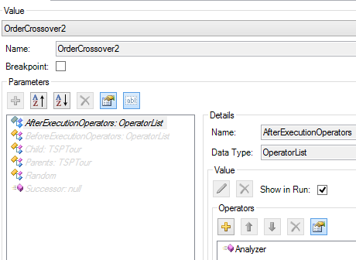
Instrumented Operators
Inherit from InstrumentedOperator
Override InstrumentedApply()
Must return base.InstrumentedApply()
Allows to configure before and after actions
Useful for analyzers, additional functionality,… without changing the algorithm
Think of aspect-oriented programming

Slide 19
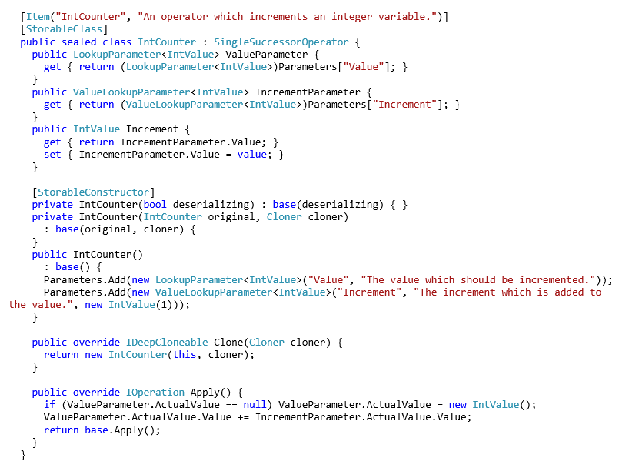
Operators
A operator that increments a value from the scope by „Increment“
For easier access to parameter values
A parameter for retrieving „Value“ (default name, can be configure with ActualValue) from scope or parent scopes
If the value is not found it can also be created in the scope

Slide 20
Algorithms and Problems
Different ways to implement algorithms and problems
Algorithms
Flexible: Inherit from HeuristicOptimizationEngineAlgorithm
Easy: Inherit from BasicAlgorithm
Problems
Flexible: Inherit from SingleObjectiveHeuristicOptimizationProblem
Easy: Inherit from [Single|Multi]ObjectiveBasicProblem

Slide 21
Base classes/interfaces for algorithms

Slide 22
Base classes/interfaces for algorithms
IExecutable (Executable):
Defines methods for starting, stopping, etc. of algorithms
IOptimizer:
Contains a run collection
IAlgorithm:
Contains a problem on which the algorithm is applied as well as a result
Algorithm:
Base class, implements IAlgorithm
EngineAlgorithm:
Extensions for execution with an engine (operator graph, scope, engine)
HeuristicOptimizationEngineAlgorithm:
Specifies problem: IHeuristicOptimizationProblem

Slide 23
What does an HL algorithm do?
Create operator graph of algorithm by chaining together operators (the actual algorithm)
Offer user configuration options through parameters
Discover operators from the operators collection of the problem/encoding
Parameterize/wire (react to changes in operators) operators where necessary

Slide 24
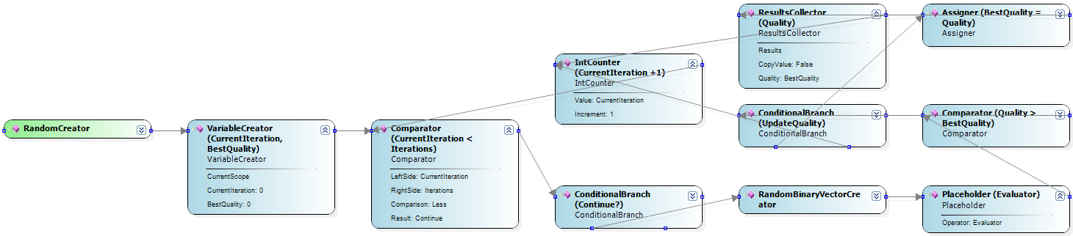
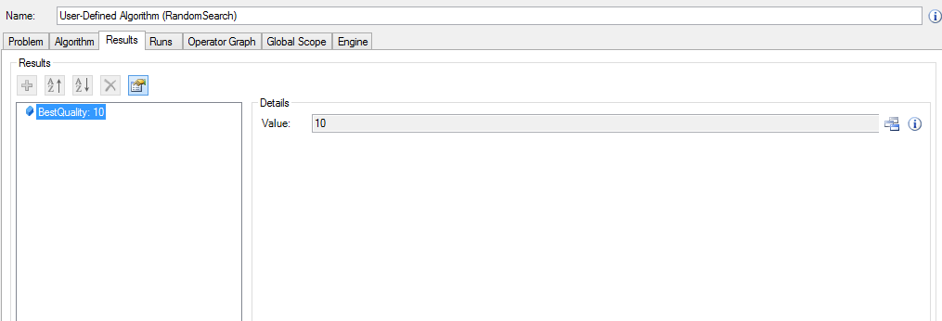
Example – Random Search

Slide 25
BasicAlgorithm
Creating an operator graph can be quite tricky
Wiring operators is error-prone
BasicAlgorithms are
Easy to implement
No boilerplate code
Hard-coded (no operator graph)
Don’t support pausing
Support mainly single problems

Slide 26
Base classes/Interfaces for BasicAlgorithm

Slide 27
BasicAlgorithm - Interface
Implement the Run method
Optional: Fix problem type
protected override void Run(CancellationToken cancellationToken)
public override Type ProblemType {
get { return typeof(BinaryProblem); }
}
public new BinaryProblem Problem {
get { return (BinaryProblem)base.Problem; }
set { base.Problem = value; }
}

Slide 28
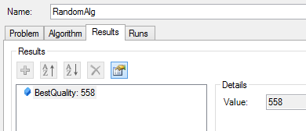
Example – Random Search
protected override void Run(CancellationToken cancellationToken) { DoubleValue bestQuality = new DoubleValue(0.0); Results.Add(new Result("BestQuality", bestQuality)); for(int i = 0; i < 100000; i++) { cancellationToken.ThrowIfCancellationRequested(); BinaryVector b = new BinaryVector(Problem.Length, random); double curQuality = Problem.Evaluate(b, random); if(Problem.Maximization && curQuality > bestQuality.Value) { bestQuality.Value = curQuality; } else if(!Problem.Maximization && curQuality < bestQuality.Value) { bestQuality.Value = curQuality; } } }

Slide 29
Problems
Use encodings for representing solutions
Encodings consist of solution candidate definitions and corresponding operators
Problems contain
the evaluator
the solution creator
Define maximization or minimization
Contain the „problem data“ (e.g., a distance matrix, a simulation, a function definition), usually supplied by a problem instance provider
Can be single- or multi-objective
Configured with parameters

Slide 30
Problem Architecture

Slide 31
Base classes/interfaces for problems

Slide 32
Base classes/interfaces for problems
IProblem:
Contains the operators collection; all operators that can be used by the problem, algorithm and user
IHeuristicOptimizationProblem:
Defines solution creator and evaluator
Problem, HeuristicOptimizationProblem and Single/MultiObjectiveHeuristicOptimizationProblem provide abstract base classes

Slide 33
Recap: What does a HL problem do?
Defines used encoding
Defines single/multi objective
Defines min/maximization
Discovers correct operators
Are used by the algorithm
Wires/parameterizes operators
Wires/parameterizes parameters
Loads problem data using a corresponding problem instance provider

Slide 34
BasicProblem
Similar concept as BasicAlgorithm
Makes implementing new problems easier
No wireing/operators necessary
Use automatic encoding configuration
Don’t work with all algorithm types, e.g., algorithms that use very specific operators
Simulated Annealing
Scatter Search
Particle Swarm Optimization

Slide 35
Base classes/interfaces for BasicProblem

Slide 36
BasicProblem - Interface
Define encoding
Define maximization or minimization
Evaluate a solution and return quality
MyNewProblem : SingleObjectiveBasicProblem<BinaryVectorEncoding>
bool Maximization { get; }
double Evaluate(Individual individual, IRandom random);

Slide 37
BasicProblem - Interface
Until now only GA variants can use the problem
Implement neighbourhood function to also use trajectory-based metaheuristics
Optional: Add analysis code for tracking results
IEnumerable<Individual> GetNeighbors(Individual individual, IRandom random);
void Analyze(Individual[] individuals, double[] qualities, ResultCollection results, IRandom random);

Slide 38
BasicProblem – Example: OneMax
class OneMaxProblem : SingleObjectiveBasicProblem<BinaryVectorEncoding> { public OneMaxProblem() { } [StorableConstructor] protected OneMaxProblem(bool deserializing) : base(deserializing) { } public OneMaxProblem(OneMaxProblem alg, Cloner cloner)
: base(alg, cloner) { } public override IDeepCloneable Clone(Cloner cloner) { return new OneMaxProblem(this, cloner); } public override bool Maximization { get{ return true; } } public override double Evaluate(Individual individual,
IRandom random) { return individual.BinaryVector().Count(b => b); } }

Slide 39
Useful Links
http://dev.heuristiclab.com/trac.fcgi/wiki/Documentation
http://dev.heuristiclab.com/trac.fcgi/wiki/Research
heuristiclab@googlegroups.com
http://www.youtube.com/heuristiclab

